Slide 1
Elixir
Day 2

Slide 2
Introduction to Mix
Mix is the default build tool for Elixir applications
Used for creating projects, compiling, managing dependencies, testing etc.
Similar to Gradle/NPM
Basic commands:
Creating a project: mix new
Compiling: mix compile
Testing: mix test
Running: mix run
Running in interactive mode: iex –S mix …

Slide 3

Demo

Slide 4
Working with Modules - alias
We use alias for setting-up module aliases
defmodule MyApp.Calculator do
def add(a, b), do: a + b
...
defmodule MyApp.Main do
alias MyApp.Calculator, as: Calc
def run() do
Calc.add(1, 2)
|> IO.inspect()
defmodule MyApp.Calculator do
def add(a, b), do: a + b
...
defmodule MyApp.Main do
alias MyApp.Calculator
def run() do
Calculator.add(1, 2)
|> IO.inspect()

Slide 5
Working with Modules - import
We use import for accessing public module functions without referencing the full function name
defmodule MyApp.Calculator do
def add(a, b), do: a + b
...
defmodule MyApp.Main do
import MyApp.Calculator
def run() do
add(1, 2) |> IO.inspect() # from Calculator module

Slide 6
Macros and use
Macros are a way to generate custom code at compile time
The keyword use injects code from a macro by calling the __using__ callback
Macros are often used when defining “interface” modules, with functions that have to be implemented

Slide 7
Macros and use (2)
defmodule MyApp.Calculator do
defmacro __using__(opts) do
if opts[:financial] == true do
quote do
def add_money(a, b), do: "Adding sums of money..."
end
end
end
def add(a, b), do: a + b
end
defmodule MyApp do
use MyApp.Calculator, financial: true
def start() do
add_money(1, 2)
|> IO.inspect
# Adding sums of money...
end
end

Slide 8
Behaviors
Behavior modules are like interfaces in other languages
They contain method definitions only, annotated with @callback
The module that implements the behavior uses the @behavior and @impl annotations

Slide 9
Behaviors (2)
defmodule MyApp.Formatter do
@callback format(String.t) :: {:ok, String.t}
End
defmodule MyApp.JsonFormatter do
@behaviour MyApp.Formatter
@impl true
def format(content) do
{:ok, "Here is some JSON content: #{content}"}
end
end

Slide 10
Demo

Slide 11
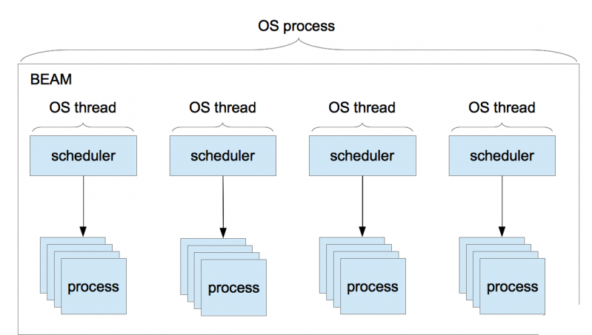
BEAM concurrency model
BEAM VM has its own scheduler
Runs lightweight processes
No shared state
Communication via message passing
… sounds familiar?

Slide 12
Concurrency model benefits
Better performance (no locks)
Fault tolerance
Easier to distribute
Built-in load balancing
Hot deployment
Scalability – up to ~268M running processes

Slide 13
Processes
All code in Elixir runs inside a process
Spawning a new process is very easy
When spawned, the process receives an ID from the scheduler
iex> spawn(fn -> 1 + 2 end)
#PID<0.113.0>

Slide 14
Sending and receiving messages
We use the send and receive functions for communication between processes
parent = self() # PID<0.41.0>
spawn(fn -> send(parent, {:hello, self()}) end) # PID<0.48.0>
receive do
{:hello, pid} -> "Got hello from #{inspect pid}"
end
# "Got hello from #PID<0.48.0>"

Slide 15
Linking Processes
By default processes are independent
If we want the error in a child process to propagate to the parent, we use spawn_link
Linking is a core feature of BEAM
Used in patterns like supervisor trees
Part of the “let it crash” philosophy

Slide 16
Demo

Slide 17
Tasks
Tasks are wrappers for processes
The Task module provides functions for starting, linking and awaiting tasks
We can create complex task hierarchies with the Task.Supervisor module

Slide 18
Demo

Slide 19
Agents
We cannot access the process state by default (immutable state)
In order to keep and access state, we use Agents
{:ok, pid} = Agent.start_link(fn -> %{} end) # {:ok, #PID<0.124.0>}
Agent.update(pid, fn state -> Map.put(state, "name", "John") end)
Agent.get(pid, fn state -> state end)
# %{"name" => "John"}
Agent.get(pid, fn state -> state["name"] end)
# "John"

Slide 20
Applications
The standard way to package Elixir projects
Each application has a main module
It should implement the Application behavior
defmodule MyApp.MixProject do
def application do
[
mod: {MyApp, []},
]
end
. . .
end
defmodule MyApp do
use Application
def start(_type, _args) do
IO.puts("Hello world")
{:ok, self()}
end
end

Slide 21
GenServers
A behavior for implementing a server module
Can handle both sync and async calls
defmodule Stack do
use GenServer
@impl true
def init(initial_state) do # initial state
. . .
@impl true
def handle_call(:pop, _from, state) do # for sync calls
. . .
@impl true
def handle_cast({:push, element}, state) do # for async calls
...

Slide 22
GenServers (2)
We interact with the GenServer like it’s a regular process
{:ok, pid} = GenServer.start_link(Stack, "hello world")
GenServer.call(pid, :pop) # sync
# "hello world"
GenServer.cast(pid, {:push, "test"}) # async
# :ok

Slide 23
Demo

Slide 24
Q & A

Slide 25
Thank you

